Slide 1
Many body tunneling

Slide 2
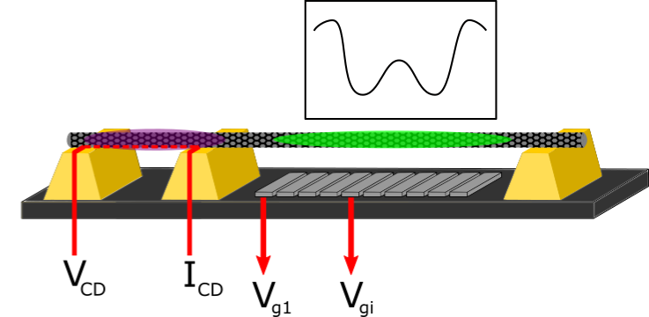
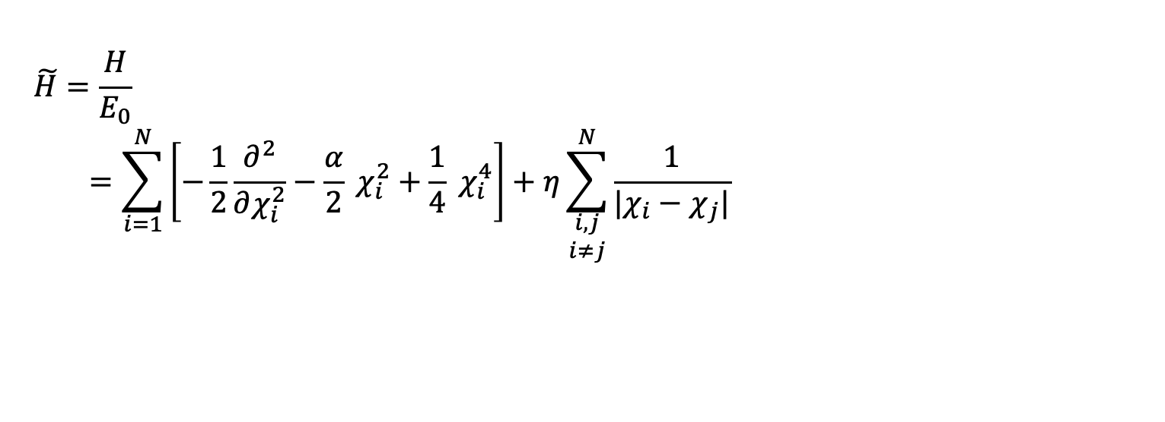
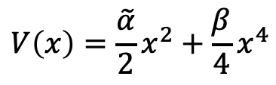
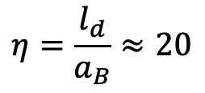
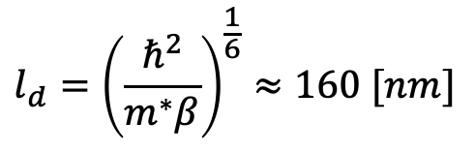

Hamiltonian:
Energy and length scales:
$$\tilde{H}=\frac{H}{E_{0}}$$
$$=\sum_{i=1}^{N}{\left[−\frac{1}{2}\frac{∂^{2}}{∂χ_{i}^{2}}−\frac{α}{2} χ_{i}^{2}+\frac{1}{4} χ_{i}^{4}\right]+η\sum_{\begin{aligned}i,j \\ i≠j\end{aligned}}^{N}{\frac{1}{|χ_{i}−χ_{j}|}}}$$
$$E_{0}=\frac{ℏ^{2}}{m^{∗}l_{d}^{2}}≈0.48 [meV]$$
$$l_{d}={\left(\frac{ℏ^{2}}{m^{∗}β}\right)}^{\frac{1}{6}}≈160 [nm]$$
Potential can be approximated as a 4th order polynomial:
Dimensionless interaction strength:
$$V\left(x\right)=\frac{\tilde{α}}{2}x^{2}+\frac{β}{4}x^{4}$$
$$η=\frac{l_{d}}{a_{B}}≈20$$

Slide 3
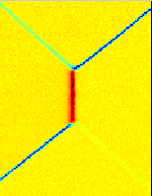






Experimental data for the many-body tunneling (1e tunneling )
$$(0,0)$$
$$V_{g}[mV]$$
$$(0,1)$$
$$(1,0)$$
$$(1,1)$$
$$ε[mV]$$
-

Slide 4
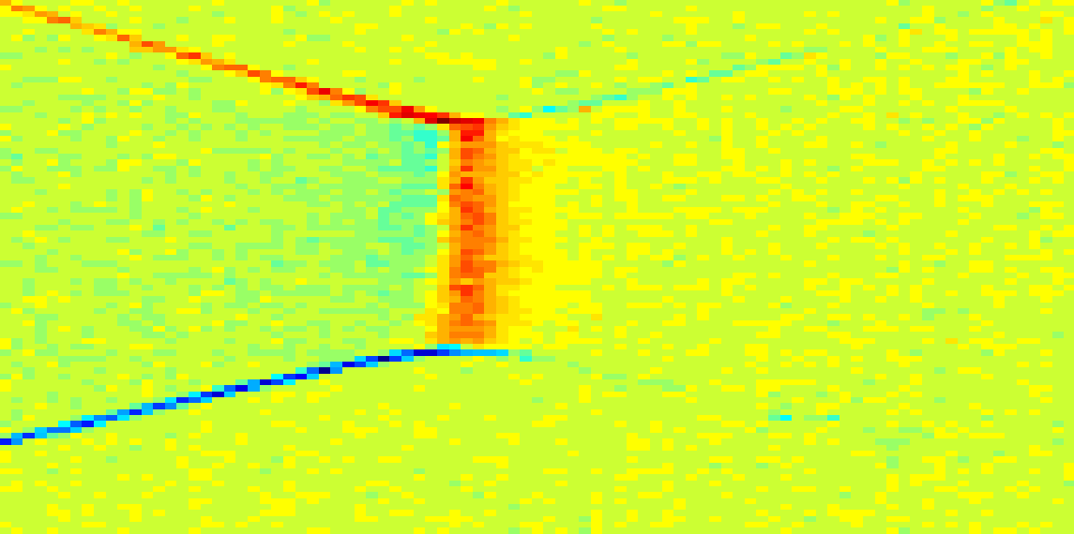



Experimental data for the many-body tunneling (3e tunneling )
$$(1,1)$$
$$V_{g}[mV]$$
$$(1,2)$$
$$(2,1)$$
$$(2,2)$$
$$ε[mV]$$
-

Slide 5
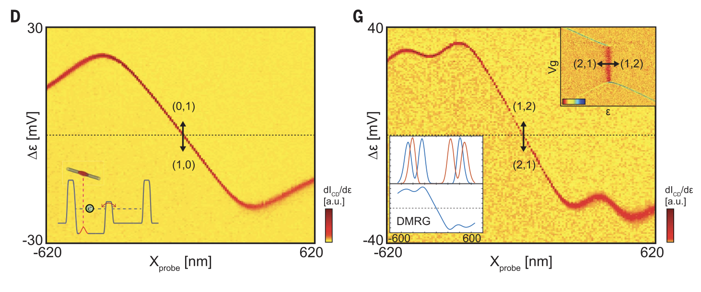
Experimental data for the many-body tunneling (1e and 3e tunneling )

Slide 6



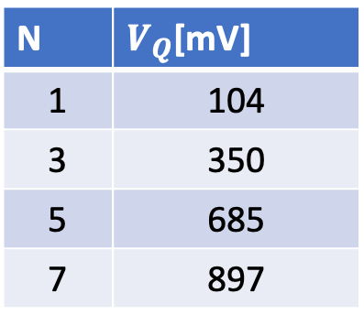



Experimental data for the many-body tunneling
50
1e
40
3e
5e
30
7e
$$Π^{−1} [mV]$$
20
10
0
100
200
300
400
500
600
700
800
900
1000
1100
$$V_{K} [mV]$$
$$V_{Q}=104$$
$$V_{Q}=350$$
$$V_{Q}=685$$
$$V_{Q}=897$$
N | $V_{Q}$[mV]
1 | 104
3 | 350
5 | 685
7 | 897

Slide 7
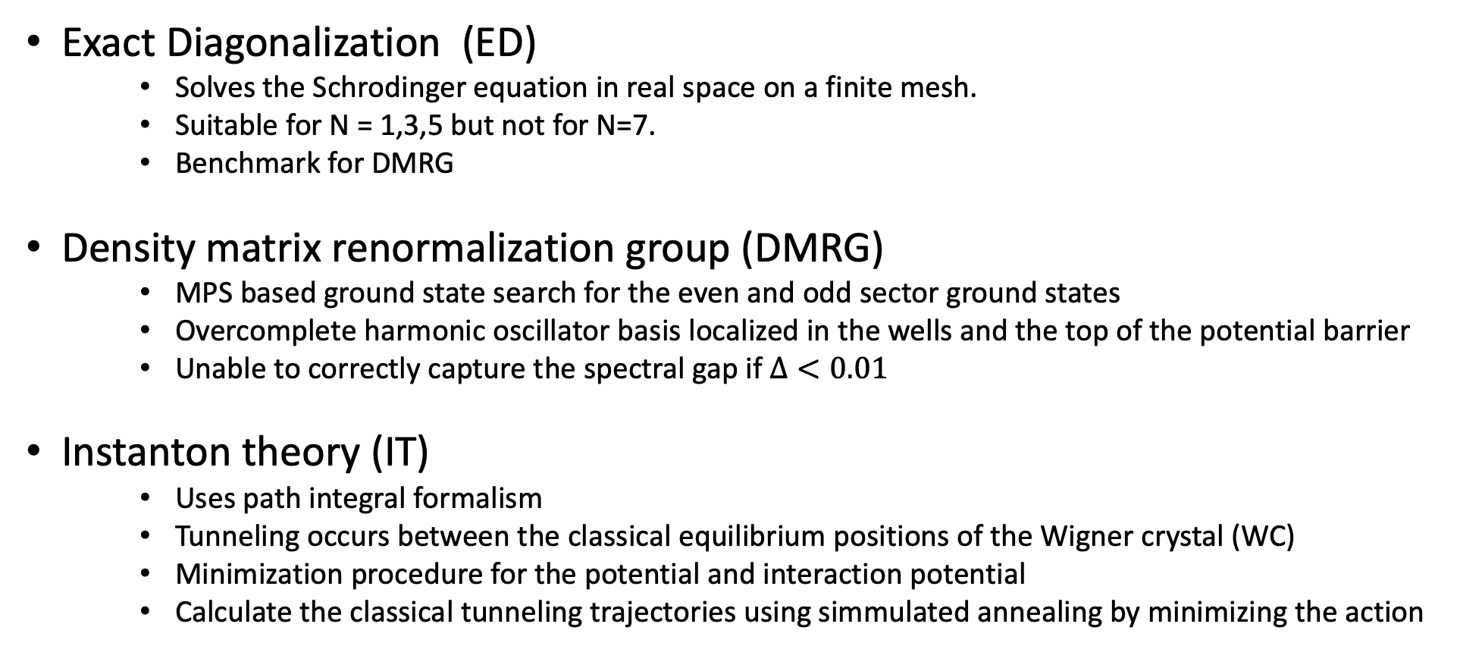
Numerical approaches
Exact Diagonalization (ED)
Solves the Schrodinger equation in real space on a finite mesh.
Suitable for N = 1,3,5 but not for N=7.
Benchmark for DMRG
Density matrix renormalization group (DMRG)
MPS based ground state search for the even and odd sector ground states
Overcomplete harmonic oscillator basis localized in the wells and the top of the potential barrier
Unable to correctly capture the spectral gap if $Δ<0.01$
Instanton theory (IT)
Uses path integral formalism
Tunneling occurs between the classical equilibrium positions of the Wigner crystal (WC)
Minimization procedure for the potential and interaction potential
Calculate the classical tunneling trajectories using simmulated annealing by minimizing the action

Slide 8

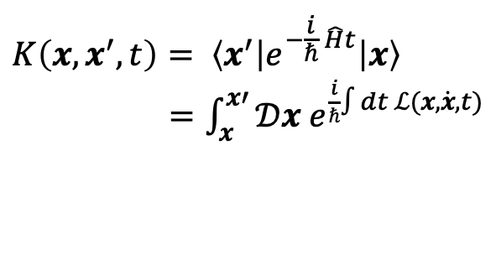
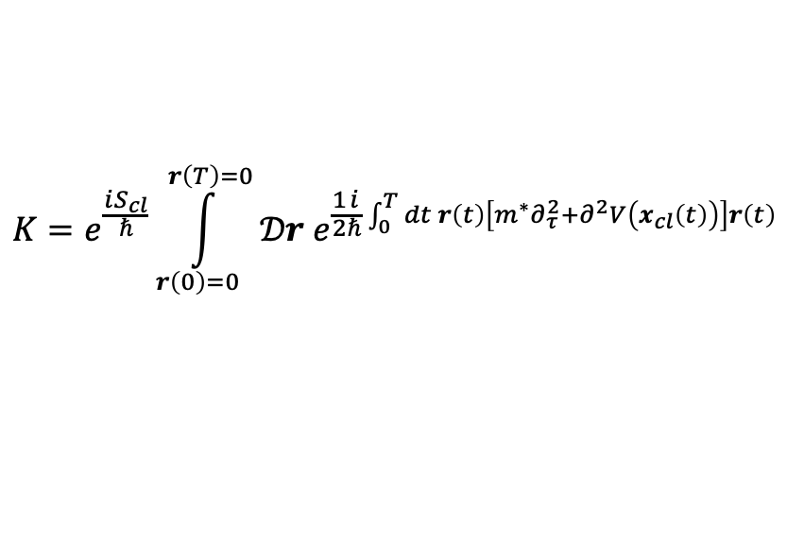
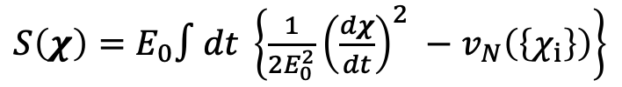
Instanton Theory: Path Integrals
Propagator in one dimension between the classical turning points x and x’:
$$K\left(x,x^{′},t\right)= \left\langle x^{′}\right|e^{−\frac{i}{ℏ} \hat{H}t}\left|x\right\rangle$$
$=\int_{x}^{x′}{\text{𝒟}x e^{\frac{i}{ℏ}∫dt ℒ(x,\dot{x},t)}}$
Saddle-point approximation
$$K=e^{\frac{iS_{cl}}{ℏ}}\int_{r\left(0\right)=0}^{r\left(T\right)=0}{𝒟r e^{\frac{1}{2}\frac{i}{ℏ}\int_{0}^{T}{dt r\left(t\right)\left[m^{∗}∂_{τ}^{2}+∂^{2}V\left(x_{cl}\left(t\right)\right)\right]r\left(t\right)}}}$$
$$S[x\left(t\right)]$$
In the exponent we find the classical action as:
$S\left(χ\right)=E_{0}∫dt \left\{\frac{1}{2E_{0}^{2}}{\left(\frac{dχ}{dt}\right)}^{2} −v_{N}\left(\left\{χ_{i}\right\}\right)\right\}$
Potential and interaction terms

Slide 9
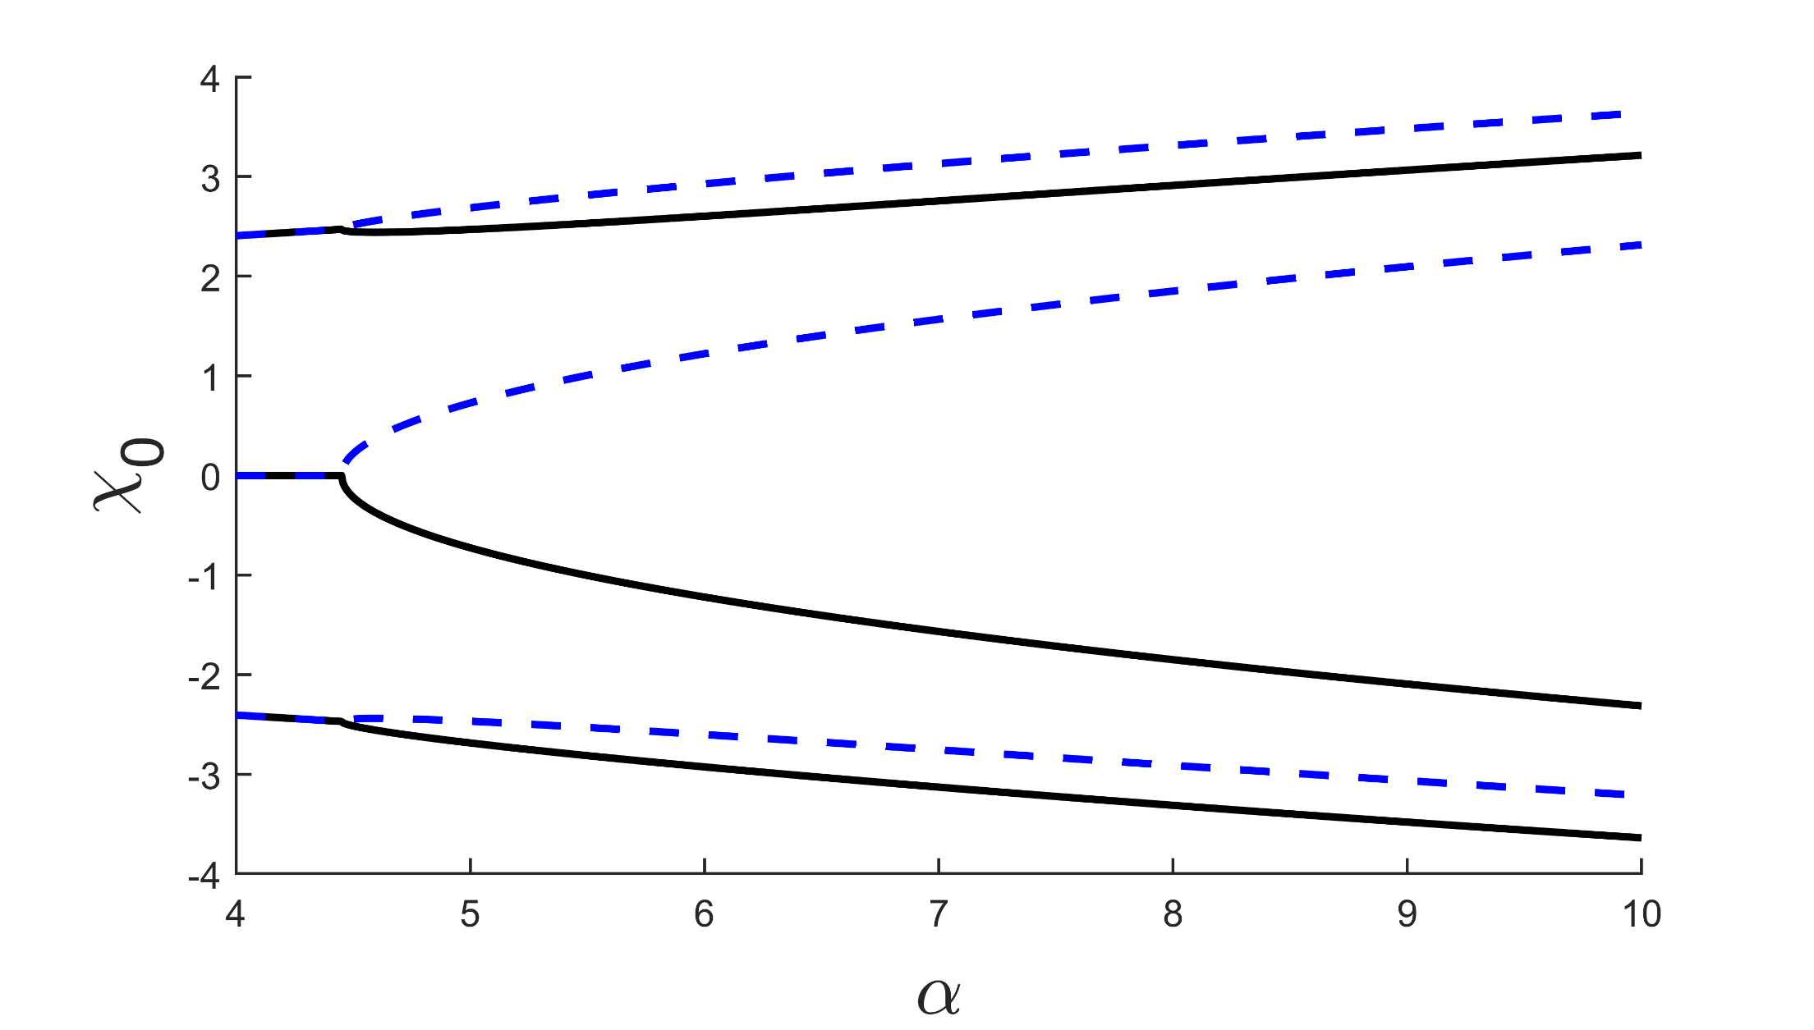
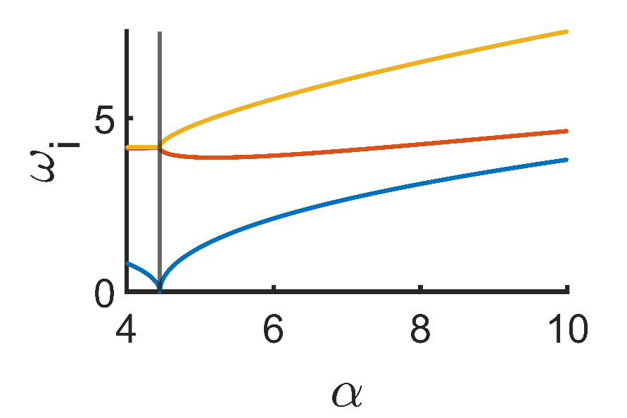

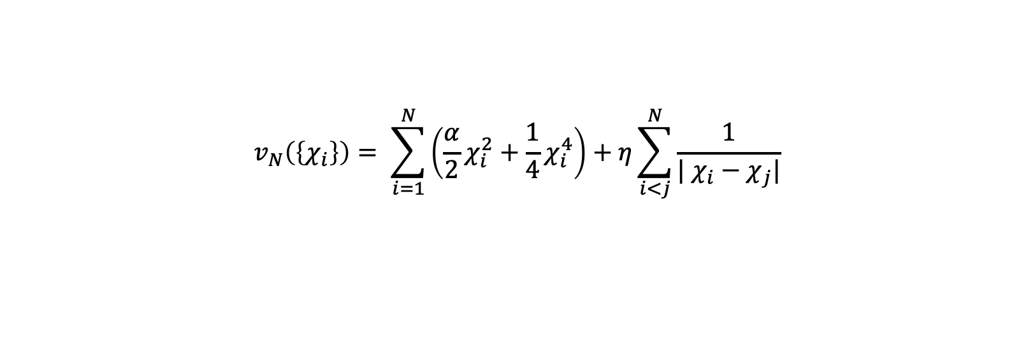

Instanton Theory: Equilibrium Positions
Tunneling occurs between the classical equilibrium positions of the Wigner crystal
Minimalization of the potential and interaction terms ($v_{N}\left(\left\{χ_{i}\right\}\right)$), this provides the turning points:
$$v_{N}\left(\left\{χ_{i}\right\}\right)= \sum_{i=1}^{N}{\left(\frac{α}{2}χ_{i}^{2}+\frac{1}{4}χ_{i}^{4}\right)+η\sum_{i<j}^{N}{\frac{1}{| χ_{i}−χ_{j}|}}}$$
Search for the normal modes at the eq. pos.
$$m^{∗} \ddot{χ}=−Dχ$$
$$m^{∗}ω^{2}A_{i}=D_{ij}A_{j}$$
Equilibrium positions and Eigenfrequencies for N = 3 electrons

Slide 10
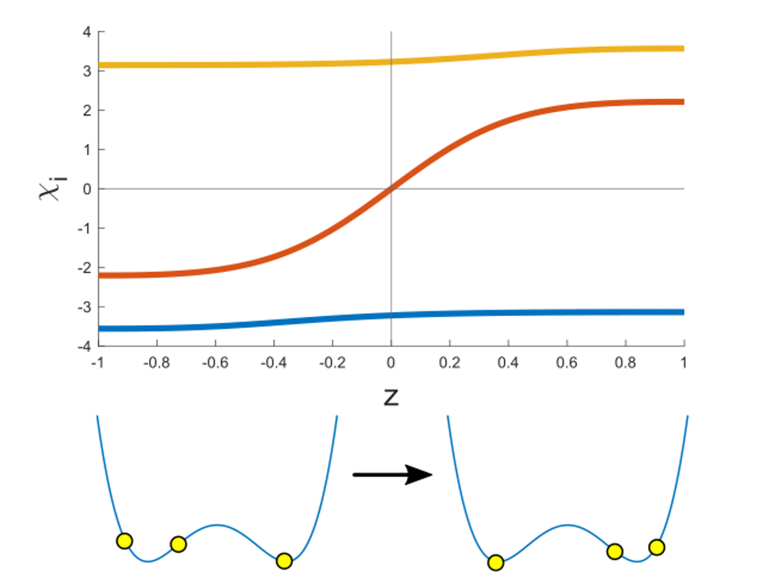


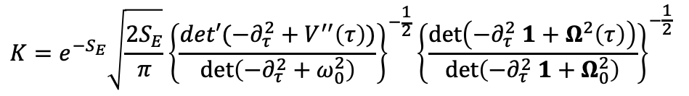

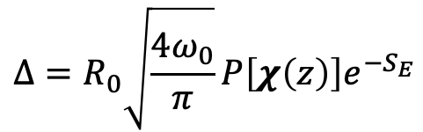
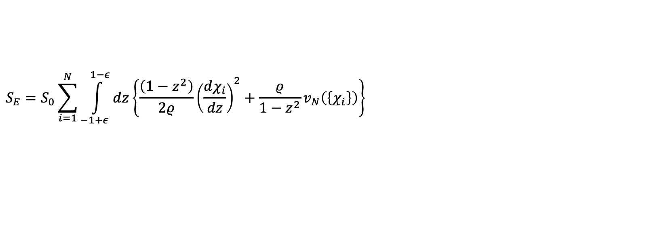
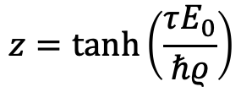
Instanton Theory: Classical trajectories
Quantum tunneling in imaginary time Wick-rotation
Trajectories for N = 3 electrons
$$t→−iτ$$
$$iS→−S_{E}=−∫dτℒ\left[x\right]$$
Time reparametrization motivated by numerics
$$z=\tanh\left(\frac{τE_{0}}{ℏρ}\right)$$
Calculating the classical tunneling trajectories
using simulated annealing by minimizing the Euclidian action:
$$S_{E}=S_{0}\sum_{i=1}^{N}{\int_{−1+ε}^{1−ε}{dz\left\{\frac{\left(1−z^{2}\right)}{2ρ}{\left(\frac{dχ_{i}}{dz}\right)}^{2}+\frac{ρ}{1−z^{2}}v_{N}\left(\left\{χ_{i}\right\}\right)\right\}}}$$
Tunnel splitting:
$$Δ=R_{0}\sqrt{\frac{4ω_{0}}{π}}P\left[χ\left(z\right)\right]e^{−S_{E}}$$
Transverse factor
$$R_{0}\sim 𝒪(10)$$
$$K=e^{−S_{E}}\sqrt{\frac{2S_{E}}{π}}{\left\{\frac{det′(−∂_{τ}^{2}+V^{′′}\left(τ\right))}{\det\left(−∂_{τ}^{2}+ω_{0}^{2}\right)}\right\}}^{−\frac{1}{2}}{\left\{\frac{\det\left(−∂_{τ}^{2} 1+Ω^{2}\left(τ\right)\right)}{\det\left(−∂_{τ}^{2} 1+Ω_{0}^{2}\right)}\right\}}^{−\frac{1}{2}}$$

Slide 11
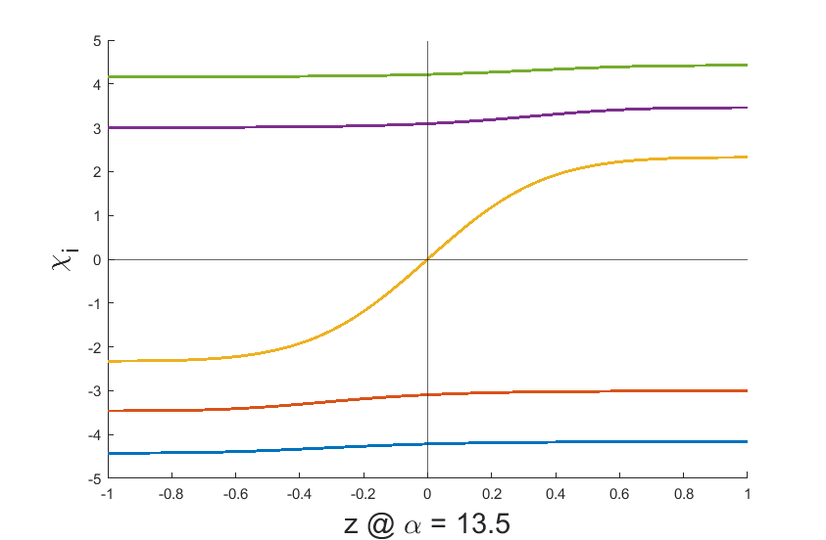
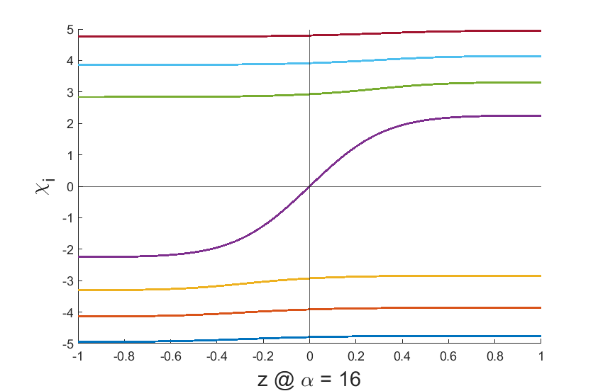
Classical trajectories 5 & 7 particles
5 particle
7 particle

Slide 12
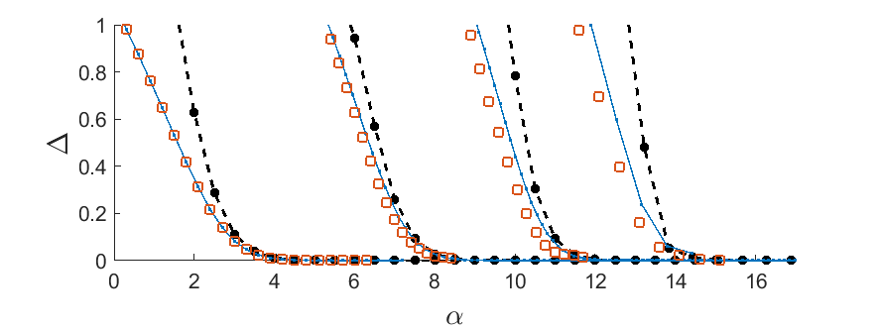
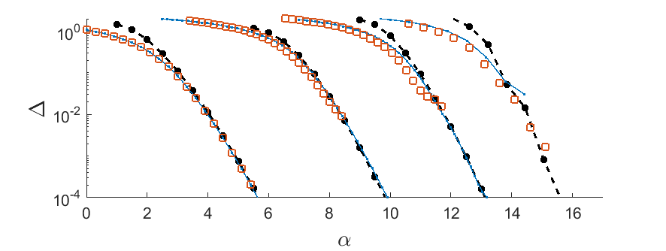
Energy gap: ED, DMRG and IT results
1e
3e
5e
7e
Orange: DMRG
Blue: ED
Black dash: Instanton

Slide 13
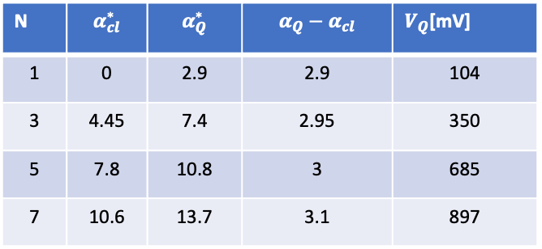
Comparison
N | $$α_{cl}^{∗}$$ | $$α_{Q}^{∗}$$ | $$α_{Q}−α_{cl}$$ | $V_{Q}$[mV]
1 | 0 | 2.9 | 2.9 | 104
3 | 4.45 | 7.4 | 2.95 | 350
5 | 7.8 | 10.8 | 3 | 685
7 | 10.6 | 13.7 | 3.1 | 897

